Slide 1
影像處理、電腦視覺及深度學習概論 (Introduction to Image Processing, Computer Vision and Deep Learning) Homework 1
TA: 吳又成
Gmail: nckubot65904@gmail.com
Office Hour: 14:00~16:00, Mon.
10:00~12:00, Thu.
At CSIE 9F Robotics Lab.

Slide 2
Notice (1/2)
Copying homework is strictly prohibited!! Penalty: Both individuals will receive a score of 0!!
Due date => 09:00:00, 2024/11/05 (Tue.)
Do not submit late, or the following points will be deducted:
Submit within seven days after the deadline, and your score will be reduced by half.
If you submit after this period, you will receive a score of 0.
You must attend the demonstration, otherwise your score will be 0. The demonstration schedule will be announced on NCKU Moodle.
You must create GUI, otherwise your point will be deducted.
Upload to => 140.116.154.28 -> Upload/Homework/Hw1
User ID: opencvdl2024 Password: RL2024opencvdl
Format
Filename: Hw1_StudentID_Name_Version.rar
Ex: Hw1_F71234567_林小明_V1.rar
If you want to update your file, you should update your version to be V2,
Ex: Hw1_F71234567_林小明_V2.rar
Content: Project folder *( Excluding the pictures ) *Note: Remove your “Debug” folder to reduce file size.

Slide 3
Notice (2/2)
Python (recommended):
Python 3.8
Opencv-contrib-python (4.10.0)
Matplotlib (3.7.3)
Numpy (1.23.5)
UI framework: pyqt5 (5.15.11)

Slide 4
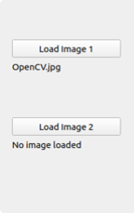
Assignment scoring (Total: 100%)
1. Image Processing
1.1 Color Separation
1.2 Color Transformation
1.3 Color Extraction
2. Image Smoothing
2.1 Gaussian filter
2.2 Bilateral filter
2.3 Median filter
3. Edge Detection
3.1 Sobel X
3.2 Sobel Y
3.3 Combination and Threshold
3.4 Gradient Angle
4. Transforms
4.1 Rotation
4.2 Scaling
4.3 Translate
(出題： Takeru)
(出題：Liu)
(出題： Ying)
* Don’t fix your image path
(There is another dataset for demonstration)
Load image 請用下面Function 來讀取路徑
QFileDialog.getOpenFileName
獲取打開的檔路徑
(出題：Tina)

Slide 5
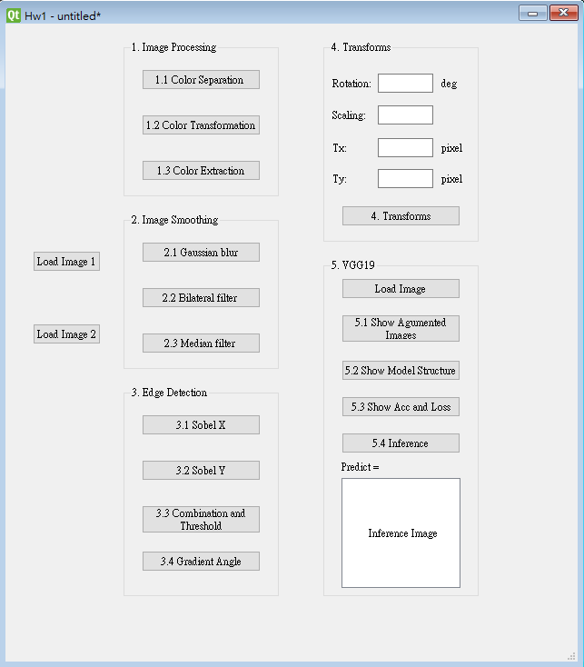
Assignment scoring (Total: 100%)
Use one UI to present 5 questions.

Slide 6
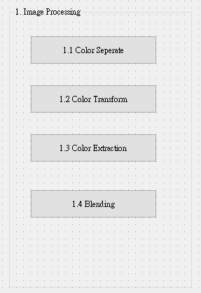
1. Image Processing
(出題：Takeru)
1.1 Color Separation
1.2 Color Transformation
1.3 Color Extraction

Slide 7
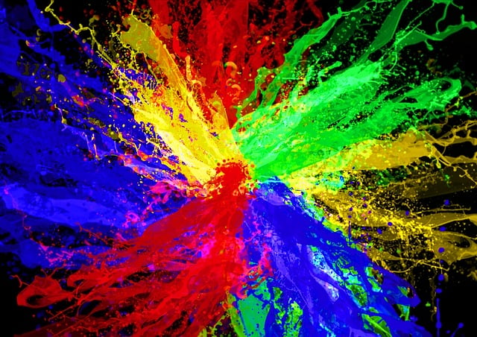
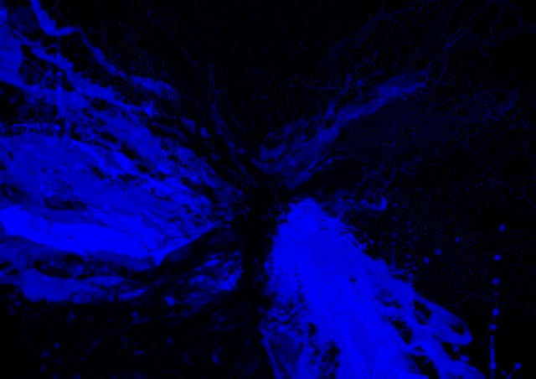
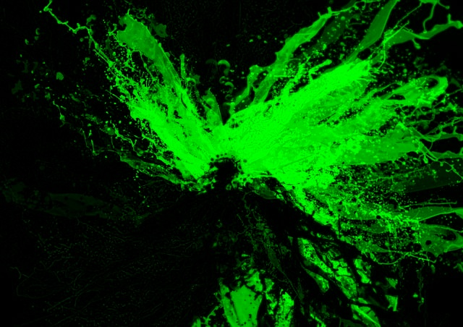
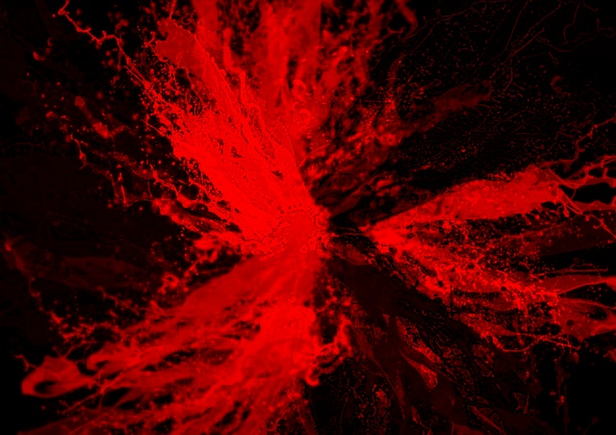
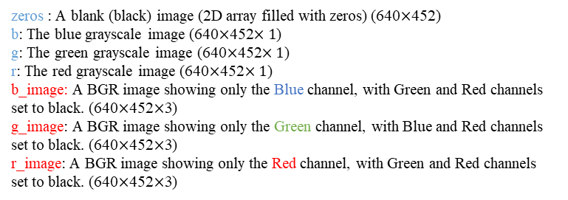
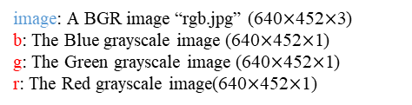
1.1 Color Separation
(出題：Takeru)
1. Given: a BGR image, “rgb.jpg”
Q: Extract 3 channels of the image BGR and show the result color images.
Use cv2.split() to get R G B gray scale images.
b, g, r = cv2.split(image)
2) Use cv2.merge() to turn each gray scale image back to BGR image, individually
b_image = cv2.merge([b, zeros, zeros])
g_image = cv2.merge([zeros, g, zeros])
r_image = cv2.merge([zeros, zeros, r])
Please show each R ,G ,B image as Figure
O/P
O/P
O/P
I/P
image: A BGR image “rgb.jpg” (640$×$452$×$3)
b: The Blue grayscale image (640$×$452$×$1)
g: The Green grayscale image (640$×$452$×$1)
r: The Red grayscale image(640$×$452$×$1)
O/P
I/P
zeros : A blank (black) image (2D array filled with zeros) (640$×$452)
b: The blue grayscale image (640$×$452$×1$)
g: The green grayscale image (640$×$452$×1$)
r: The red grayscale image (640$×$452$×1$)
b_image: A BGR image showing only the Blue channel, with Green and Red channels set to black. (640$×$452$×$3)
g_image: A BGR image showing only the Green channel, with Blue and Red channels set to black. (640$×$452$×$3)
r_image: A BGR image showing only the Red channel, with Green and Red channels set to black. (640$×$452$×$3)
image (rgb.jpg)
b_image
g_image
r_image

Slide 8
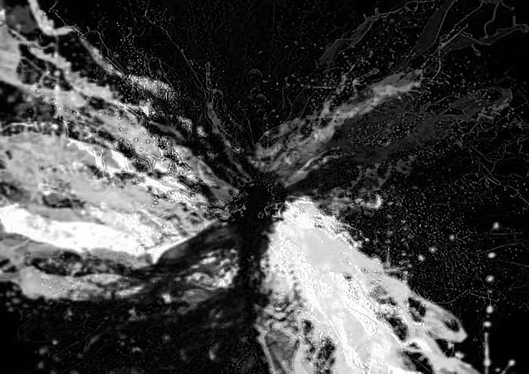
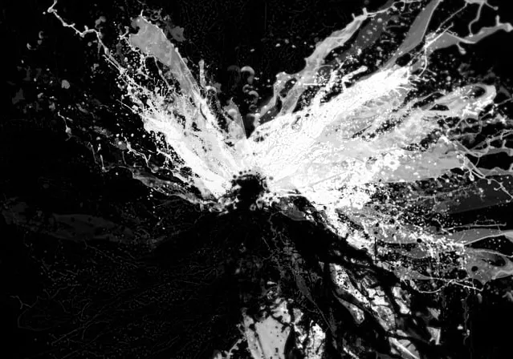
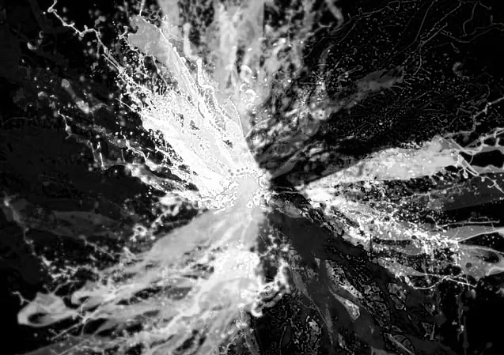
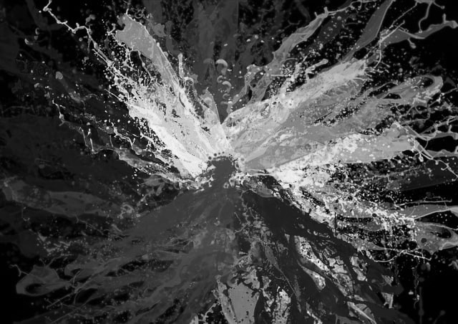
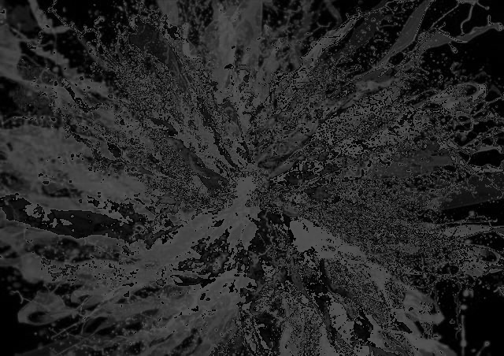
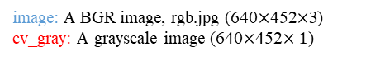
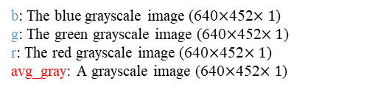
1.2 Color Transformation
(出題：Takeru)
2. Given: A BGR image, “rgb.jpg”
Q: Transform “rgb.jpg” into grayscale by
Q1): Call OpenCV function cv2.cvtColor(…, cv2.COLOR_BGR2GRAY) on rgb.jpg to generate Image cv_gray
cv_gray = cv2.cvtColor(image, cv2.COLOR_BGR2GRAY)
Q2): Merge BGR separated channel images from problem 1.1 to generate avg_gray = (r+g+b)/3.
avg_gray = (b/3 + g/3 + r/3).astype(np.uint8)
O/P
I/P
image: A BGR image, rgb.jpg (640$×$452$×$3)
cv_gray: A grayscale image (640$×$452$×1$)
Fig. Q1
O/P
I/P
I/P
I/P
b: The blue grayscale image (640$×$452$×1$)
g: The green grayscale image (640$×$452$×1$)
r: The red grayscale image (640$×$452$×1$)
avg_gray: A grayscale image (640$×$452$×1$)
Convert to an 8-bit unsigned integer format
(values between 0 and 255)
Fig. Q2
b
g
r
image (rgb.jpg)
Result from problem 1.1 (1)
Fig. Q1) cv_gray
Fig. Q2) avg_gray
Perceptually weighted formula:
cv_gray= 0.299r + 0.587g + 0.114 b
Average weighted formula
avg_gray= (b+g+r)/3

Slide 9
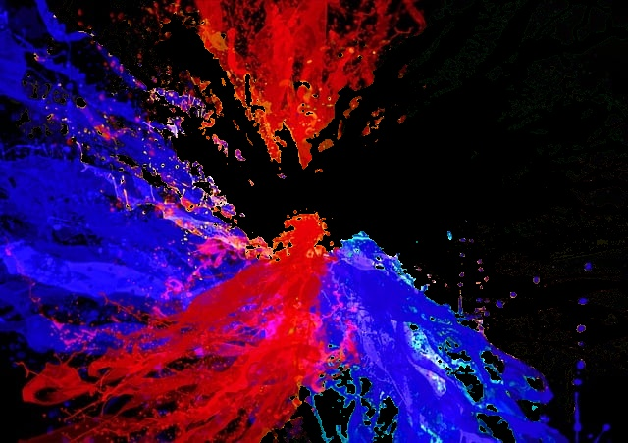
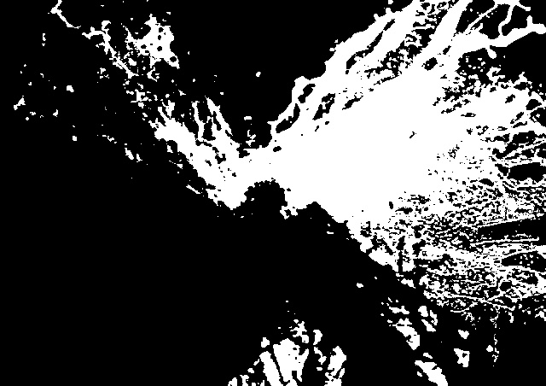
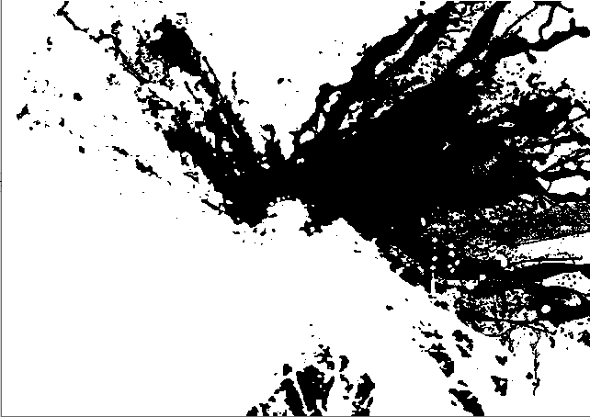
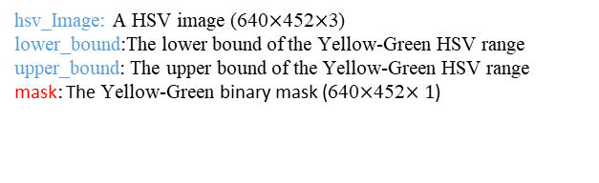
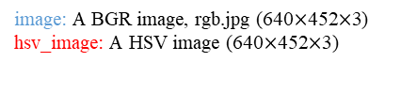
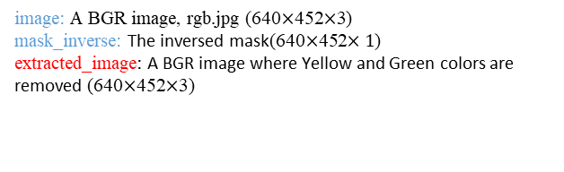
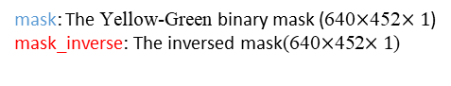
(出題：Takeru)
1.3 Color Extraction
3. Given: A BGR image, “rgb.jpg”
Q: Show the Yellow-Green mask I₁ and the image with Yellow and Green colors removed I₂.
1) Transform “rgb.jpg” from BGR format to HSV format: cv2.cvtColor(image, cv2.COLOR_BGR2HSV)
hsv_image = cv2.cvtColor(image, cv2.COLOR_BGR2HSV)
2) Yellow-Green mask I₁ by calling : cv2.inRange(hsv_image , lower_bound , upper_bound)
mask = cv2.inRange(hsv_image, lower_bound, upper_bound)
3) Invert the mask I₁ by calling: cv2.bitwise_not(mask)
mask_inverse = cv2.bitwise_not(mask)
4) Remove Yellow and Green color in the image to generate I₂ by calling : cv2.bitwise_and(image, image ,mask_inverse)
extracted_image = cv2.bitwise_and(image, image, mask=mask_inverse)
O/P
I/P
image: A BGR image, rgb.jpg (640$×$452$×$3)
hsv_image: A HSV image (640$×$452$×$3)
Please refer to the next slide
O/P
I/P
I/P
I/P
hsv_Image: A HSV image (640$×$452$×$3)
lower_bound:The lower bound of the Yellow-Green HSV range
upper_bound: The upper bound of the Yellow-Green HSV range
mask: The Yellow-Green binary mask (640$×$452$×1$)
I₁
I₁
O/P
I/P
mask: The Yellow-Green binary mask (640$×$452$×1$)
mask_inverse: The inversed mask(640$×$452$×1$)
O/P
I/P
I/P
I/P
image: A BGR image, rgb.jpg (640$×$452$×$3)
mask_inverse: The inversed mask(640$×$452$×1$)
extracted_image: A BGR image where Yellow and Green colors are removed (640$×$452$×$3)
I₂
I₂
rgb.jpg
Image without yellow
and green I₂
Yellow-Green mask I₁
The inversed mask

Slide 10
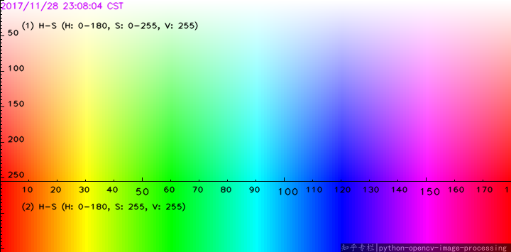
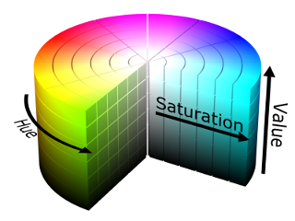
(出題：Takeru)
1.3 Color Extraction
Yellow-Green HSV range
Hue (H): 18-85
Saturation (S): 0-255
Value (V): 25-255
HSV values ranges between
(h:0–180, s:0–255, v:0–255)
H(Hue) : x axis
S(Saturation) : y axis
V(Value) : 255
255
0
255
Yellow-Green mask range
0
REF: https://medium.com/@gowtham180502/how-to-detect-colors-using-opencv-python-98aa0241e713

Slide 11
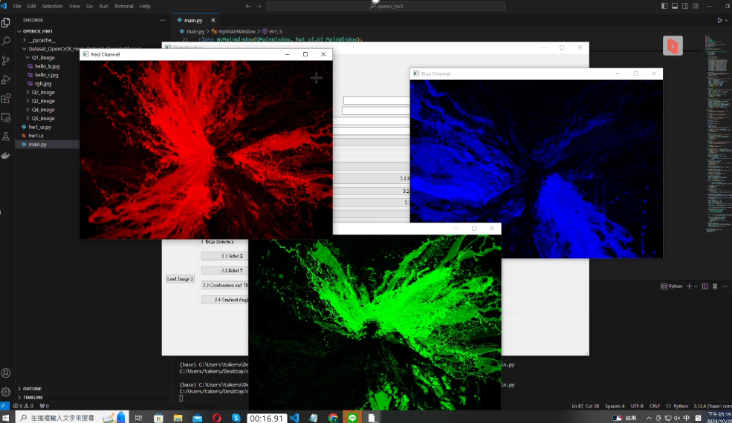
1. Image Processing– Demo Video
(出題：Takeru)

Slide 12
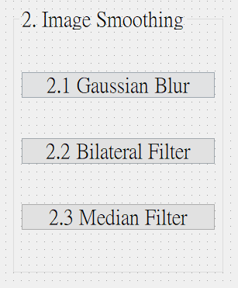
2. Image Smoothing
(出題：Liu)
2.1 Gaussian blur
2.2 Bilateral filter
2.3 Median filter
Hint
Textbook Chapter 3, p. 50 ~ 52, p.109~115

Slide 13
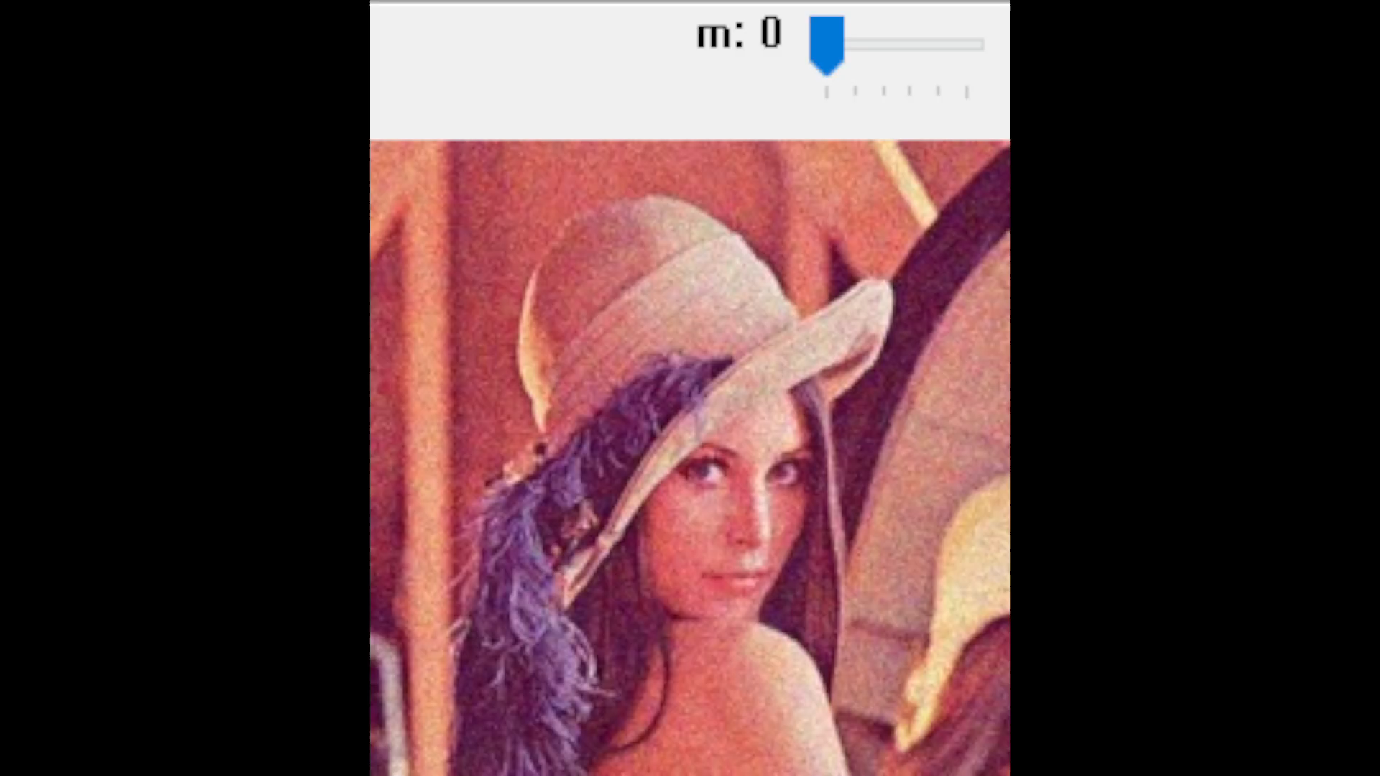

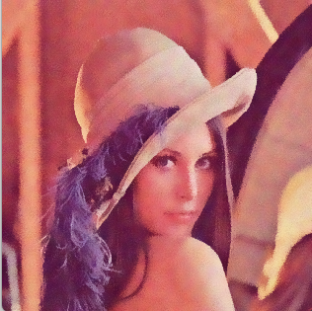
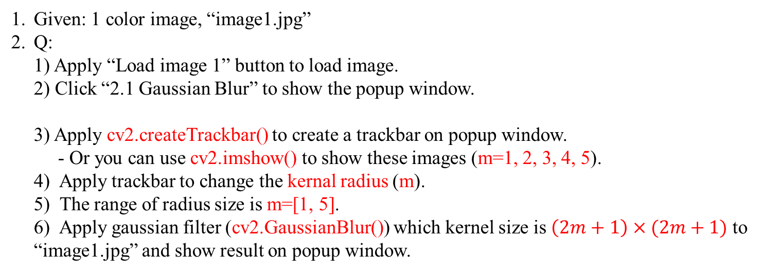
2.1 Gaussian Filter
(出題：Liu)
image: original image “image1.jpg”
kernal: kernal size of gaussian filter, which is (2m + 1) x (2m + 1)
sigmaX: standard deviation in the X direction
sigmaY: standard deviation in the Y direction
blur: image with gaussian blur
Given: 1 color image, “image1.jpg”
Q:
1) Apply “Load image 1” button to load image.
2) Click “2.1 Gaussian Blur” to show the popup window.
3) Apply cv2.createTrackbar() to create a trackbar on popup window.
- Or you can use cv2.imshow() to show these images (m=1, 2, 3, 4, 5).
4) Apply trackbar to change the kernal radius (m).
5) The range of radius size is m=[1, 5].
6) Apply gaussian filter (cv2.GaussianBlur()) which kernel size is $\left(2m+1\right)×(2m+1)$ to “image1.jpg” and show result on popup window.
O/P
I/P
I/P
I/P
I/P
I/P
blur = cv2.GaussianBlur(image, (kernal, kernal), sigmaX, sigmaY)
O/P
Gaussian vs. Bilateral at m=5
Gaussian
Bilateral
image1.jpg

Slide 14
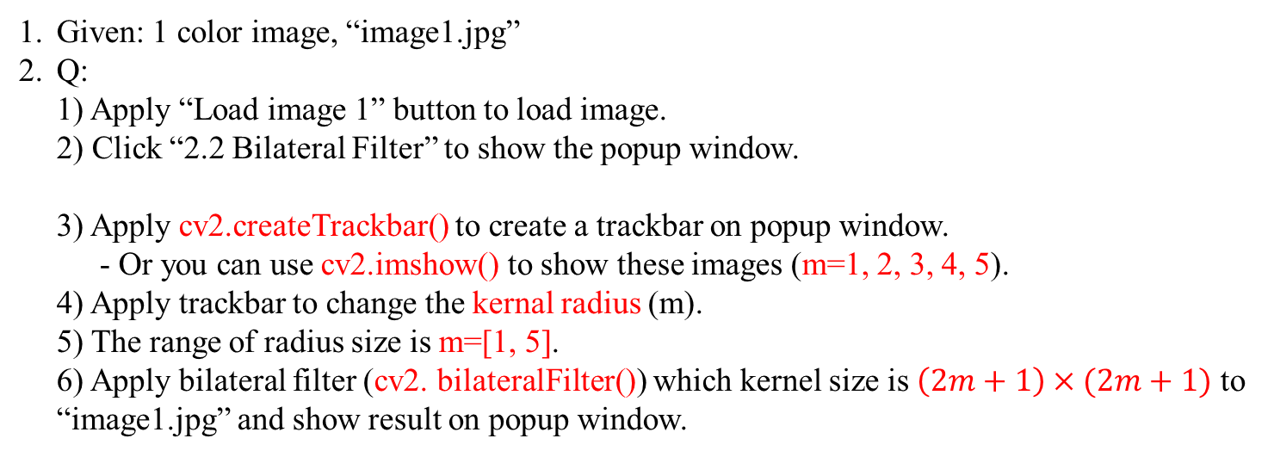
2.2 Bilateral Filter
(出題：Liu)
image: original image “image1.jpg”
d: Diameter of Pixel Neighborhood. ex: d=5 means 5x5 pixel area ➔ m=2 for (2m + 1) x (2m + 1)
sigmaColor: Filter Sigma in Color Space
sigmaSpace: Filter Sigma in Coordinate Space
bilateral: image after applying bilateral filter
Given: 1 color image, “image1.jpg”
Q:
1) Apply “Load image 1” button to load image.
2) Click “2.2 Bilateral Filter” to show the popup window.
3) Apply cv2.createTrackbar() to create a trackbar on popup window.
- Or you can use cv2.imshow() to show these images (m=1, 2, 3, 4, 5).
4) Apply trackbar to change the kernal radius (m).
5) The range of radius size is m=[1, 5].
6) Apply bilateral filter (cv2. bilateralFilter()) which kernel size is $\left(2m+1\right)×(2m+1)$ to “image1.jpg” and show result on popup window.
像素之間的顏色差異對濾波結果的影響程度
像素之間的距離對濾波結果的影響程度，當d>0時此參數無作用，但因輸入需要此參數，所以將其設置與 sigmaSpace 相等就好。
O/P
I/P
I/P
I/P
I/P
bilateral = cv2. bilateralFilter(image, d, sigmaColor, sigmaSpace)
Hint
simgaColor = 90, sigmaSpace = 90
sigmaColor 範例: 假設有個3x3的bilateral filter，sigmaColor設為100
O/P
針對第1個pixel，中心與其差距為240-150=90 < 100 (SigmaColor)，則第1個pixel會參與濾波
150 | 10 | 60
80 | 240 | 110
40 | 200 | 90
針對第7個pixel，中心與其差距為240-40=200 > 100 (SigmaColor)，則第7個pixel不會參與濾波
image1.jpg

Slide 15
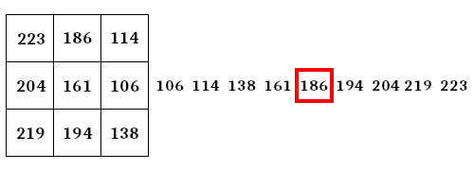
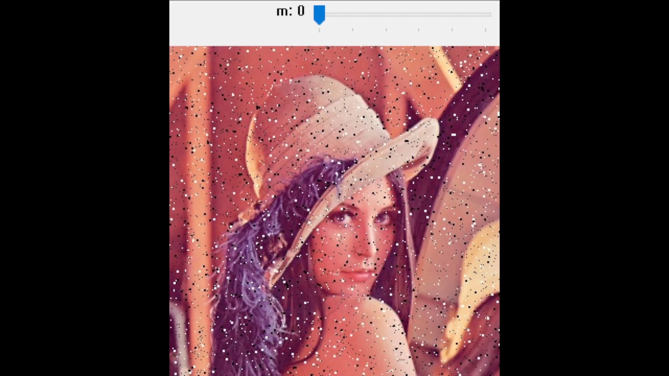
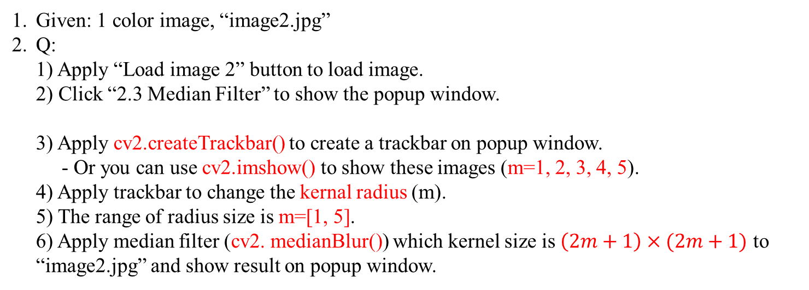
2.3 Median Filter
(出題：Liu)
Given: 1 color image, “image2.jpg”
Q:
1) Apply “Load image 2” button to load image.
2) Click “2.3 Median Filter” to show the popup window.
3) Apply cv2.createTrackbar() to create a trackbar on popup window.
- Or you can use cv2.imshow() to show these images (m=1, 2, 3, 4, 5).
4) Apply trackbar to change the kernal radius (m).
5) The range of radius size is m=[1, 5].
6) Apply median filter (cv2. medianBlur()) which kernel size is $\left(2m+1\right)×(2m+1)$ to “image2.jpg” and show result on popup window.
image: original image “image1.jpg”
kernal: kernal size of median filter, which is (2m + 1) x (2m + 1)
median: image after applying median filter
O/P
I/P
I/P
median = cv2. medianBlur(image, kernal)
O/P
Median filter example
image2.jpg

Slide 16
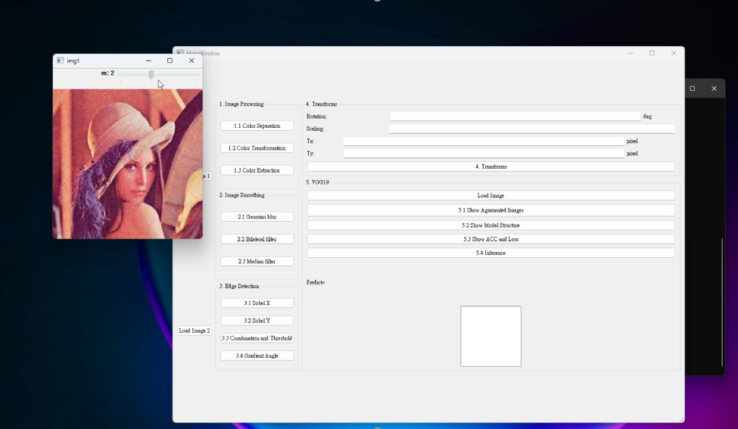
2. Image Smoothing– Demo Video
(出題：Liu)

Slide 17
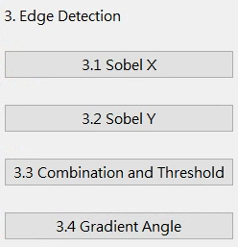
3. Edge Detection
(出題：Ying)
3.1 Sobel X
3.2 Sobel Y
3.3 Combination and Threshold
3.4 Gradient Angle

Slide 18
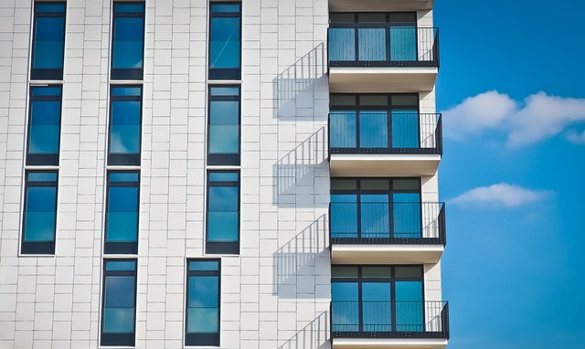
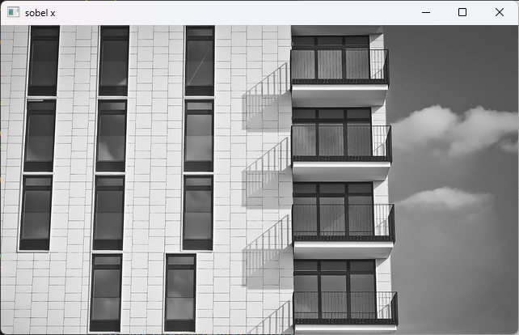
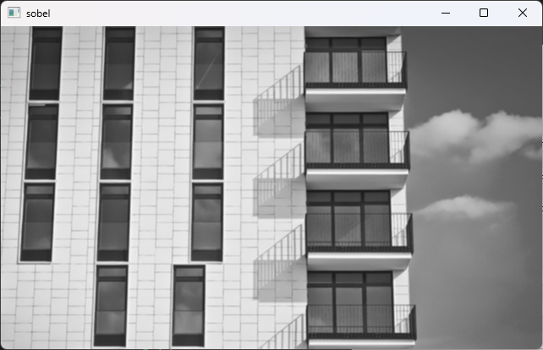
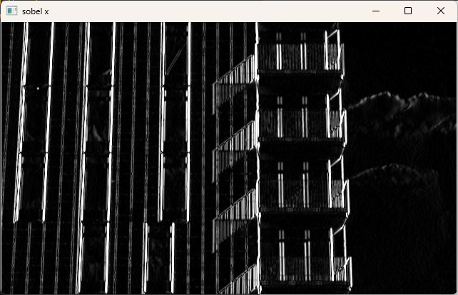
3.1 Sobel x
(出題： Ying)
1. Given: A RGB image, “building.jpg”
2. Q: Generate Sobel x image for “building.jpg”
Convert the RGB image into a grayscale image
Smooth grayscale image with Gaussian smoothing filter.
Apply Sobel edge detection to detect vertical edge by your own 3x3 Sobel x operator. (Can not use OpenCV Function cv2.Sobel and cv2.filter2D.)
Please show the result with cv2.imshow function.
Hint: Textbook Chapter 6, p.144 ~ 149
image: original image “building.jpg”
gray: grayscale image
kernal: kernal size of gaussian filter, which is (2m + 1) x (2m + 1)
sigmaX: standard deviation in the X direction
sigmaY: standard deviation in the Y direction
blur: image with gaussian blur
O/P
I/P
gray = cv2.cvtColor(image, cv2.COLOR_BGR2GRAY)
O/P
I/P
I/P
I/P
I/P
I/P
blur = cv2.GaussianBlur(gray, (kernal, kernal), sigmaX, sigmaY)
Convert into grayscale image
I/P: building.jpg
Gaussian smoothing
Grayscale Image
-1 | 0 | 1
-2 | 0 | 2
-1 | 0 | 1
Apply Sobel x filter on blur image
Blur image
O/P: Sobel x
18

Slide 19
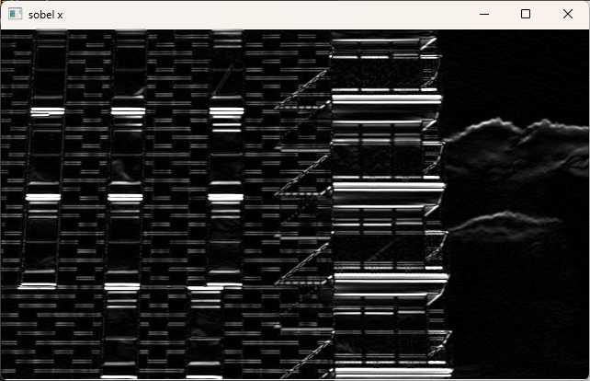
3.2 Sobel y
(出題： Ying)
1. Given: A RGB image, “building.jpg”
2. Q: Generate Sobel x image for “building.jpg”
Convert the RGB image into a grayscale image
Smooth grayscale image with Gaussian smoothing filter.
Apply Sobel edge detection to detect horizontal edge by your own 3x3 Sobel x operator. (Can not use OpenCV Function cv2.Sobel and cv2.filter2D.)
Please show the result with cv2.imshow function.
Hint: Textbook Chapter 6, p.144 ~ 149
image: original image “building.jpg”
gray: grayscale image
kernal: kernal size of gaussian filter, which is (2m + 1) x (2m + 1)
sigmaX: standard deviation in the X direction
sigmaY: standard deviation in the Y direction
blur: image with gaussian blur
O/P
I/P
gray = cv2.cvtColor(image, cv2.COLOR_BGR2GRAY)
O/P
I/P
I/P
I/P
I/P
I/P
blur = cv2.GaussianBlur(gray, (kernal, kernal), sigmaX, sigmaY)
Convert into grayscale image
I/P: building.jpg
Gaussian smoothing
Grayscale Image
-1 | -2 | -1
0 | 0 | 0
1 | 2 | 1
Blur image
Apply Sobel y filter on blur image
O/P: Sobel y
19
19

Slide 20
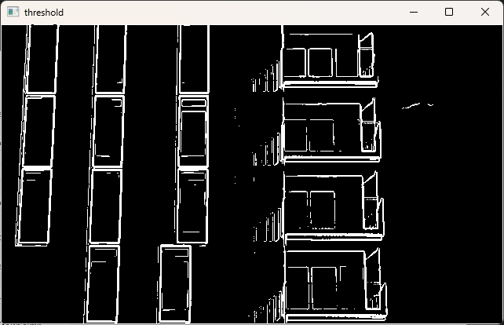
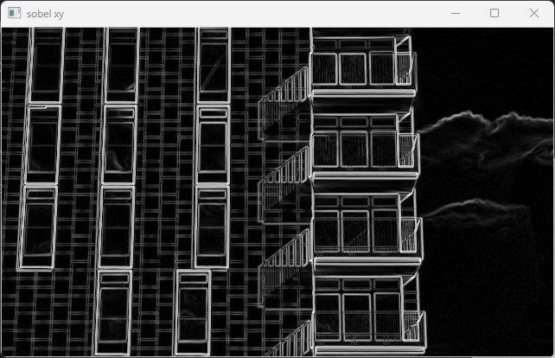
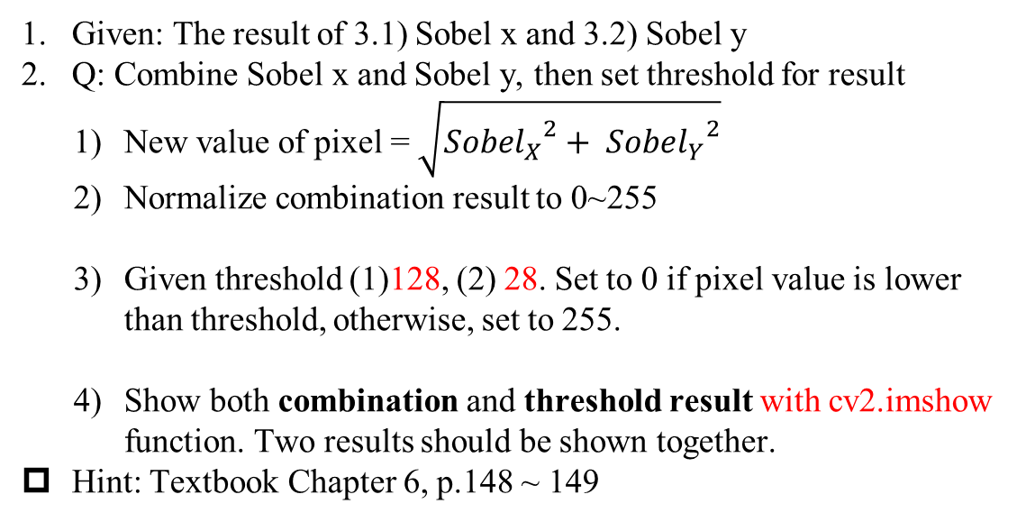
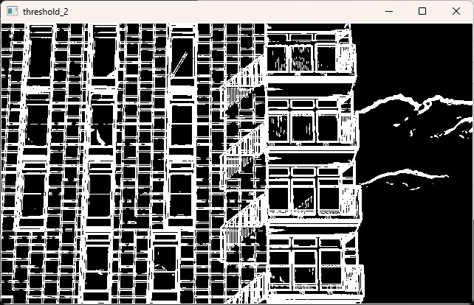
3.3 Combination and Threshold
(出題： Ying)
1. Given: The result of 3.1) Sobel x and 3.2) Sobel y
2. Q: Combine Sobel x and Sobel y, then set threshold for result
New value of pixel = $\sqrt{{{Sobel}_{X}}^{2}+ {{Sobel}_{Y}}^{2}}$
Normalize combination result to 0~255
Given threshold (1)128, (2) 28. Set to 0 if pixel value is lower than threshold, otherwise, set to 255.
Show both combination and threshold result with cv2.imshow function. Two results should be shown together.
Hint: Textbook Chapter 6, p.148 ~ 149
combination: image combined with Sobelx & Sobely
min: the minimum value for normalization
max: the maximum value for normalization
normalized: the resulting image after normalization
O/P
I/P
I/P
I/P
normalized = cv2.normalize(combination, None, min, max, cv2.NORM_MINMAX)
0
255
thresh: the threshold value
maxval: the maximum value in the grayscale range
result: the resulting image after applying the threshold to “normalized”
O/P
I/P
I/P
I/P
_, result = cv2.threshold(normalized, thresh, maxval, cv2.THRESH_BINARY)
128
255
$$\sqrt{{{Sobel}_{X}}^{2}+ {{Sobel}_{Y}}^{2}}$$
I/P: Sobel x
O/P (1): Threshold=128
Combination of Sobel x and Sobel y
I/P: Sobel y
O/P (2): Threshold=28
20

Slide 21
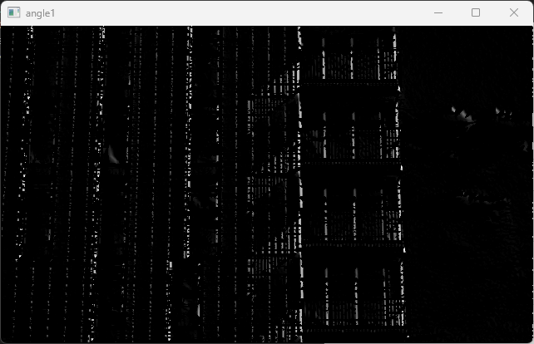
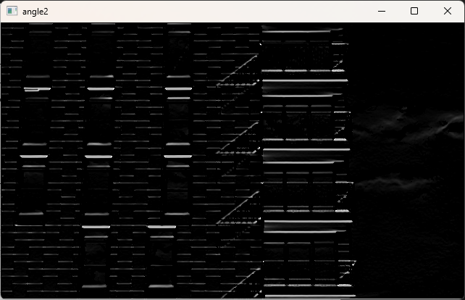
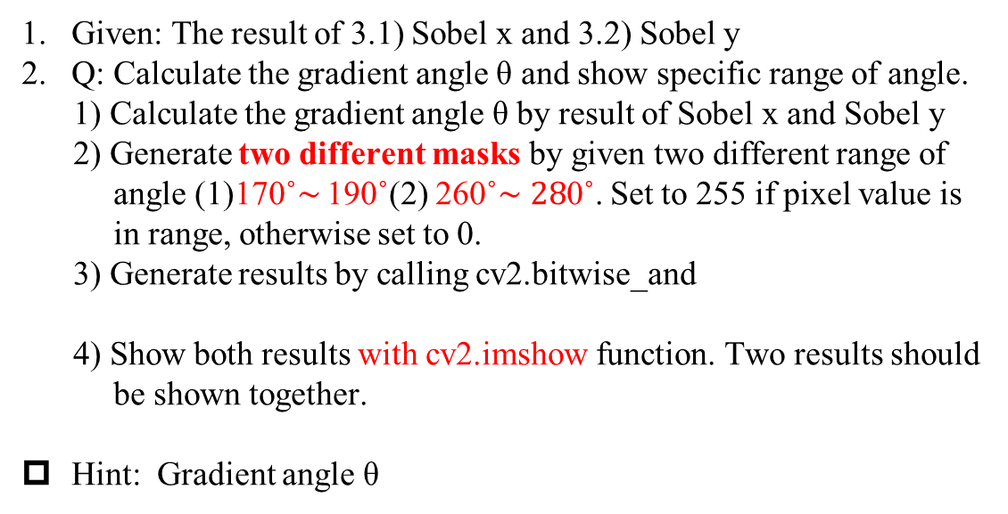
3.4 Gradient Angle
(出題：Ying)
1. Given: The result of 3.1) Sobel x and 3.2) Sobel y
2. Q: Calculate the gradient angle θ and show specific range of angle.
1) Calculate the gradient angle θ by result of Sobel x and Sobel y
2) Generate two different masks by given two different range of angle (1)170˚$\sim$ 190˚(2) 260˚$\sim 28$0˚. Set to 255 if pixel value is in range, otherwise set to 0.
3) Generate results by calling cv2.bitwise_and
4) Show both results with cv2.imshow function. Two results should be shown together.
Hint: Gradient angle θ
img1: The first input image (combination image from 3.3)
img2: The second input image (your masks), which is used for the bitwise AND operation with img1
output: result image
O/P
I/P
I/P
output = cv2.bitwise_and(img1, img2)
90˚
y axis: Sobel y
180˚
θ
0˚/360 ˚
x axis: Sobel x
270˚
O/P (1)
O/P (2)
21

Slide 22
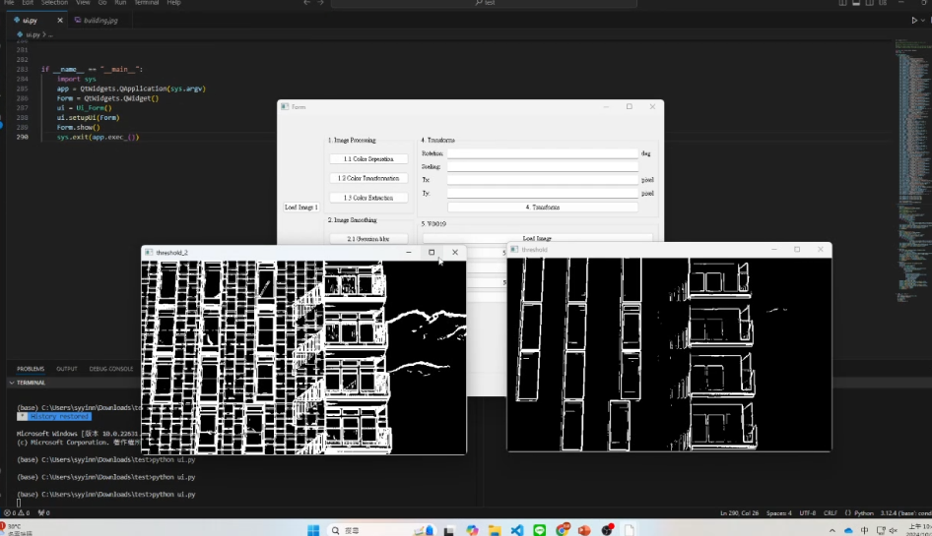
3. Edge Detection - DEMO
(出題：Ying)

Slide 23
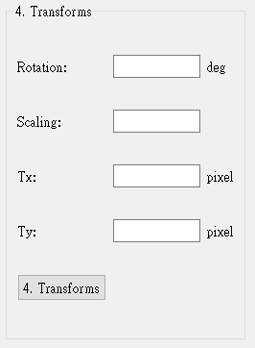
4. Transforms
(出題：Tina)
4.1 Rotation
4.2 Scaling
4.3 Translate
UI Demo:

Slide 24







4. Transforms
(出題：Tina)
1. Given: “burger.png”
2. Q: 1) Click button “4. Transforms”, burger.png should be showed.
2) Please rotate, scale and translate the burger (as image below) using
result = cv2.warpAffine(img, M, (w,h))
function with following parameters
(set default values 0, should be manually adjusted in the GUI)
(1) Angle = 30º (positive degree➔ counter-clockwise)
(2) Scale = 0.9,
(3) Translation with:
X_{new} = X_{old} + 535 pixels = 240 + 535 = 775
Y_{new} = Y_{old} + 335 pixels = 200 + 335 = 535
- Point C (240, 200) is center point of burger in original image - Point C’(775, 535) is center point of burger in result image
Hint: Textbook Chapter 12, (p.407 ~ 412)
O/P
I/P
I/P
I/P
img: image burger.png.
M: affine transformation matrix(3x3).
(w, h): width and height from image(1920x1080).
result: image after affine transformation
$M_{(Scale= 0.9)}$ = $\left[\begin{matrix}0.9 & 0 & 0 \\ \begin{aligned}0 \\ 0\end{aligned} & \begin{aligned}0.9 \\ 0\end{aligned} & \begin{aligned}0 \\ 1\end{aligned}\end{matrix}\right]$
$M_{\text{(}\text{Angle}\text{ = }\text{30}\text{o}\text{)}}$ = $\left[\begin{matrix}\cos\left(30°\right) & −\sin{(\text{30}\text{o}\text{)}} & 0 \\ sin(\text{30}\text{o}\text{)} & \cos\left(30°\right) & 0 \\ 0 & 0 & 1\end{matrix}\right]$
$M_{(Translation= 535, 335)}$ = $\left[\begin{matrix}1 & 0 & 535 \\ 0 & 1 & 335 \\ 0 & 0 & 1\end{matrix}\right]$
Rotation, Scale: Object center not move
Translation: Object center move
Result Demo:
$M^{′}$: affine transformation with
counter-clockwise 30 , scaling = 0.9, translation with 535, 335.
(0, 0)
$M^{′}$ = $M_{(Translation= 535, 335)}$x$M_{(Scale= 0.9)}$ x$M_{\text{(}\text{Angle}\text{ = }\text{30}\text{o}\text{)}}$
(0, 0)
C (240, 200)
$$M^{′}$$
30º
C’ (775, 535)
Input Image
(1920, 1080)
Output Image
(1920, 1080)

Slide 25

4. Transforms - DEMO
(出題：Tina)

